Slide 1
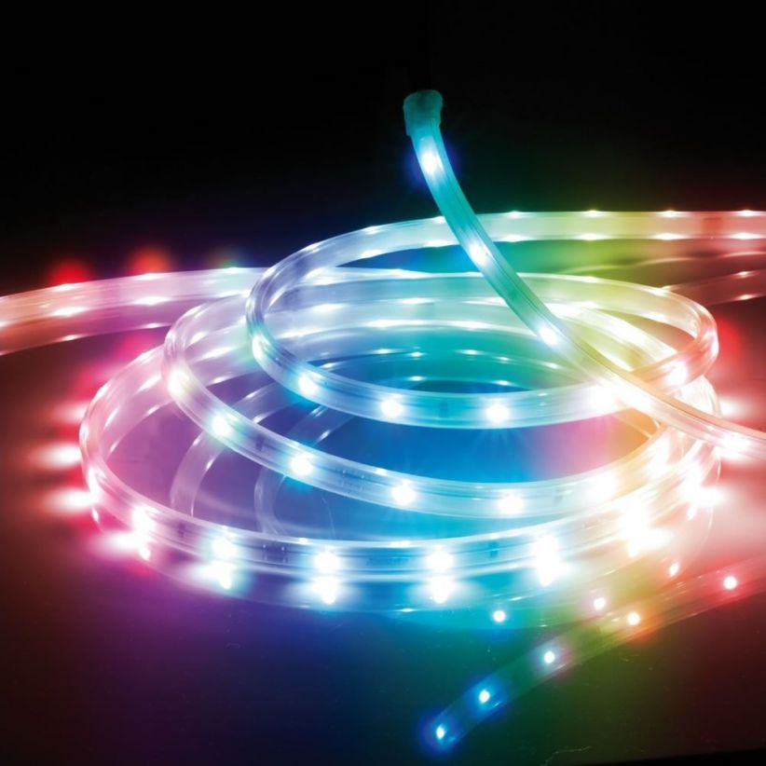
LED CONTROLLER
Callum burn’s Oregan
Ethan Dahi Germain

Slide 2
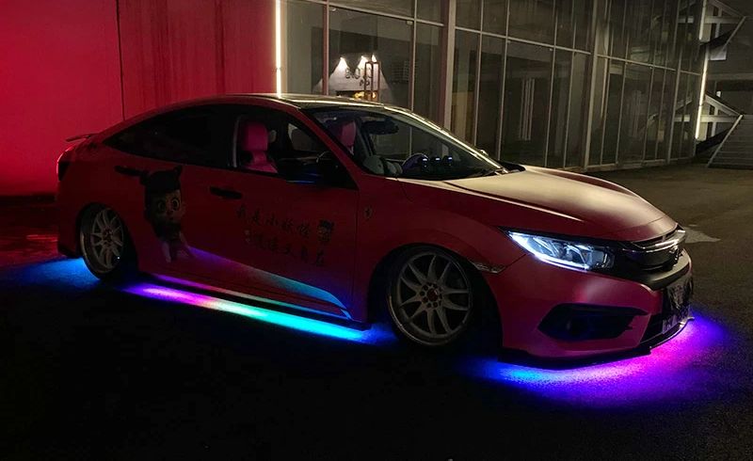
LED TUNNING CAR

Slide 3
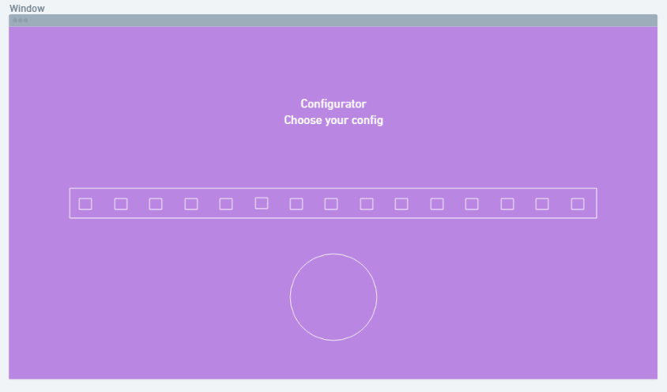
IHM

Slide 4
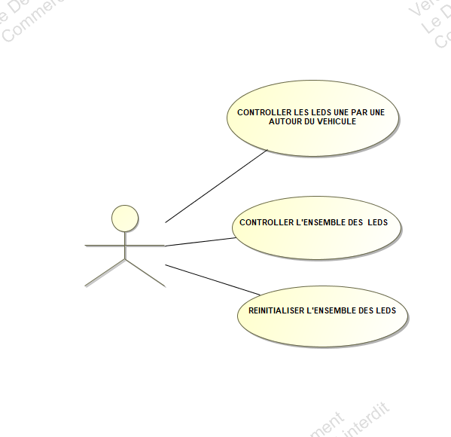
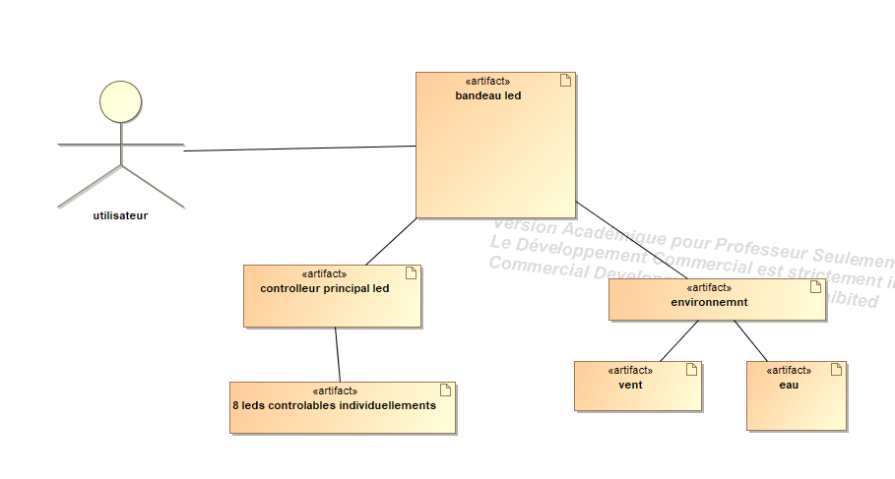
SYSML

Slide 5


